Slide 1
Term Project for
CS673 – Software Engineering
Focused Study
(Iteration 3)
Project Presentation by
Siddhesh Dighe
Paridhi Talwar
Deepali Chawla
Pushkar Gharat
Sai Ramya Devineni
Ayush Bhaliya
Supriya

Slide 2
Team Members
Siddhesh Dighe - Team Leader Paridhi Talwar - Requirement Leader
Deepali Chawla- Configuration Leader Pushkar Gharat - Design Implementation Leader
Sai Ramya Devineni - QA Leader
Supriya - Backup QA Leader
Ayush Bhaliya - Security Leader

Slide 3
What is Focused Study?
It’s a web app that aims to solve the issue of distractions and declining attention spans when it comes to learning
Distraction-Free Learning
Gamification
Analytics Dashboard
User’s can search for educational videos using a single search bar on Home page
Rewarding users points for staying focused on learning
Providing insights on users attention span and learning habits
Each video is selected based on multiple factors like best comments, likes-dislike ratio, views
These points can be used to watch more entertainment-focused videos aligned to users hobbies & interests.

Slide 4
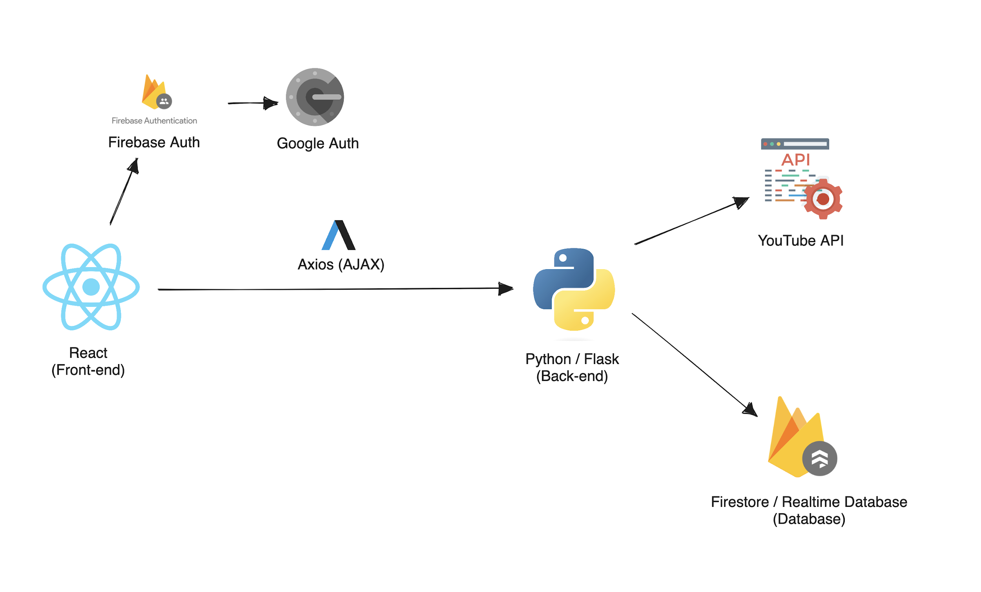
Tech Stack

Slide 5
Functional Requirements
Essential Requirements
Desirable Requirements
Search for Videos
Video-Watching Experience
User Metrics
Comparing Watch History
Authentication and Project Management
Entertainment feed to redeem points
Earn points by staying focused

Slide 6
Non-Functional Requirements
Performance Requirements
Platform is smooth and seamless
Quick loading of the video
Able to handle multiple users at the same time.

Slide 7
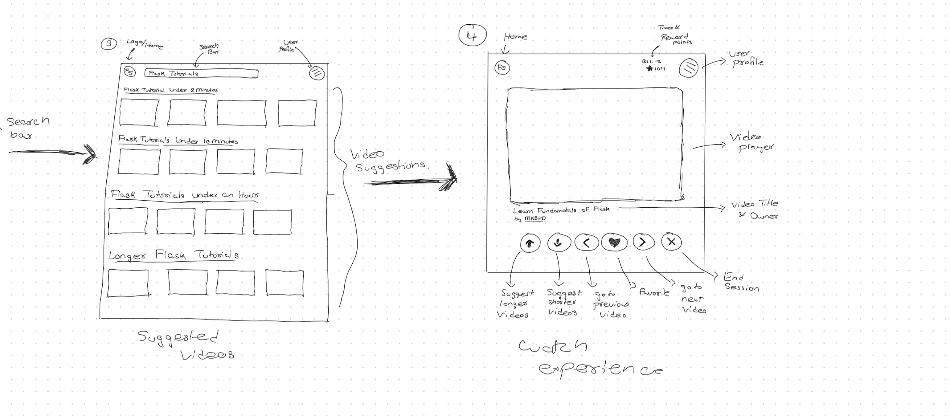
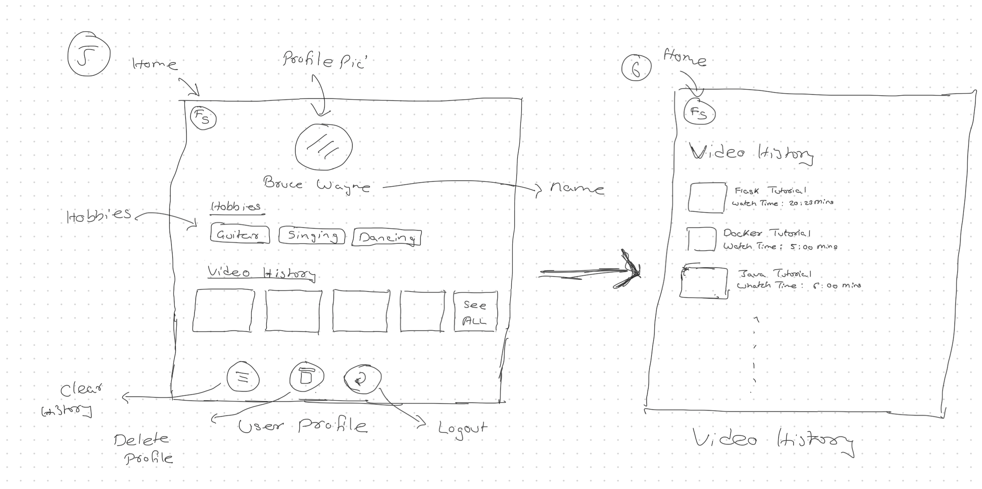
Wireframes
Low fidelity wireframes helped us visualize the flow of the app better
It also helped us identify & tackle some useability issues before we started development
Why low fidelity wireframes?
Its easy modify compared to high fidelity wireframes
Helped focus on the structure of the app rather than more peculiar design details

Slide 8
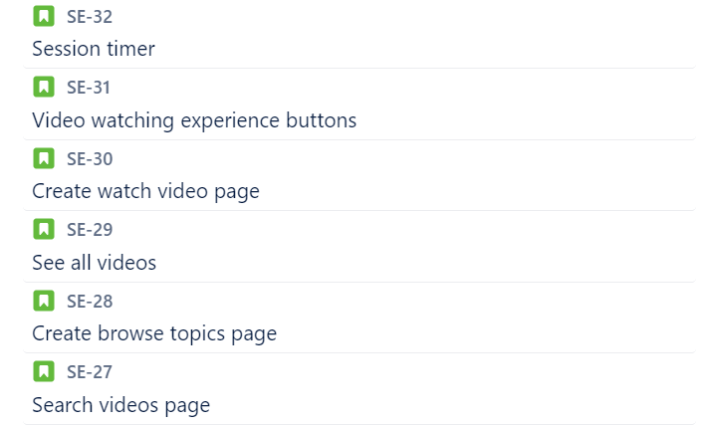
User Stories
With help of the wireframes, we could write user stories which were more detailed (down to each button on the screen)
This won’t just help us make the task more easy to understand but it also makes UI Testing easier and more organized
Once each user story was reviewed, we added them to the JIRA board so that we can track them

Slide 9
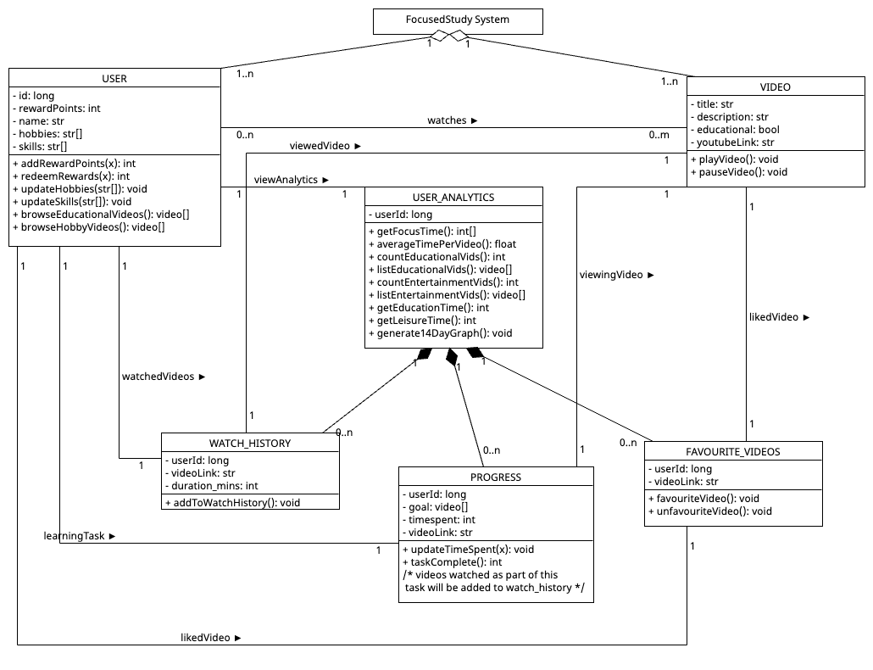
Class Diagram

Slide 10
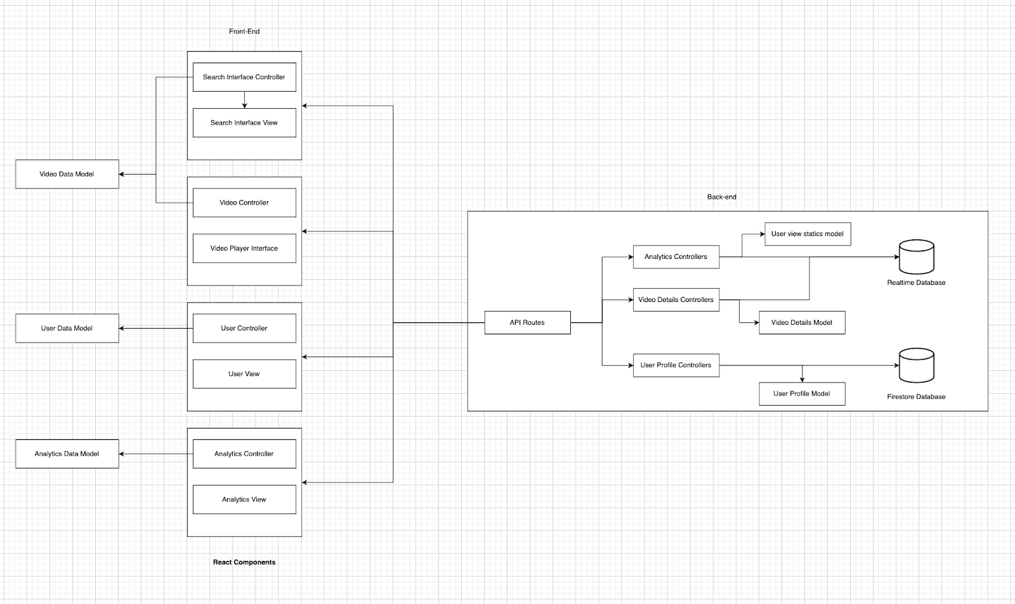
Software Architecture

Slide 11
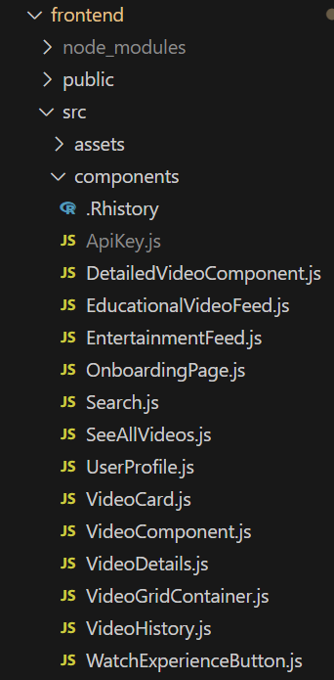
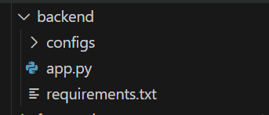
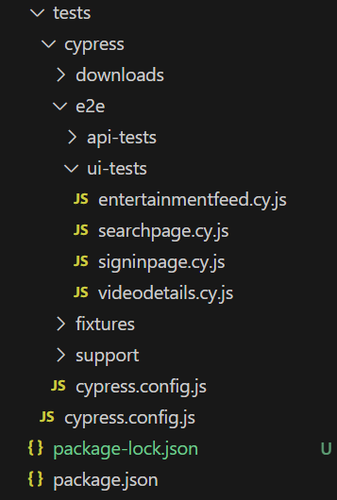
Project Structure
Backend
Frontend
Test Cases

Slide 12
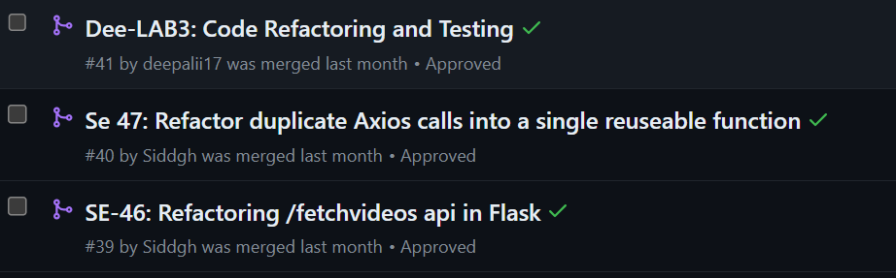
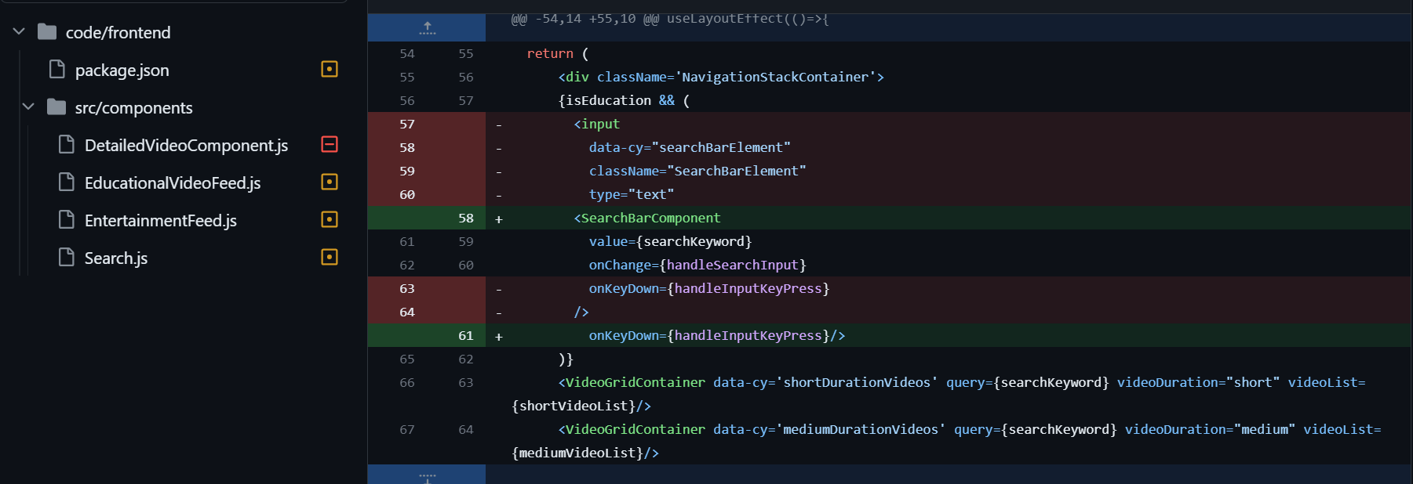
Refactoring Examples

Slide 13
Testing
Manual
Automated
Unit Tests Each member is responsible for adding unit tests for the features.
GitHub Action Tester We’ll be using this tool for automatically running the test cases for each new pull request
UI Tests We would use Cypress for testing applications user interface.
Integration Tests QA Leader would be responsible for adding integration tests.

Slide 14
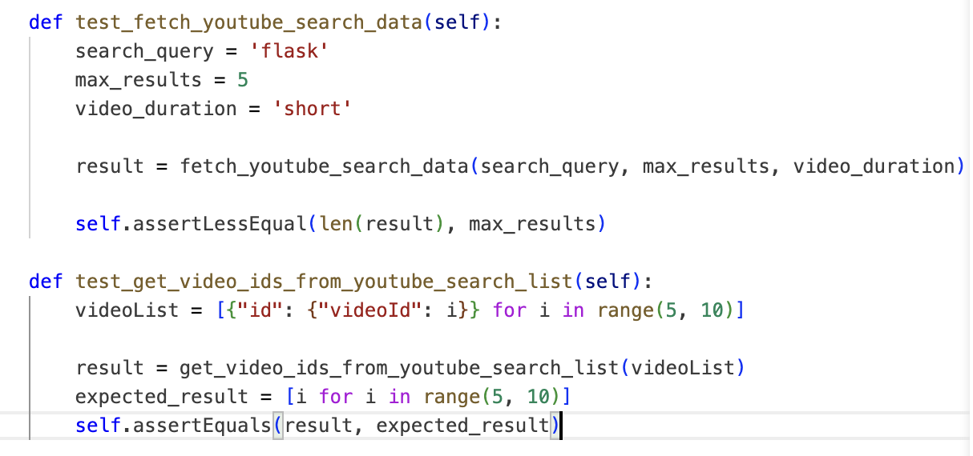
Testing
Manual
Unit Tests :

Slide 15
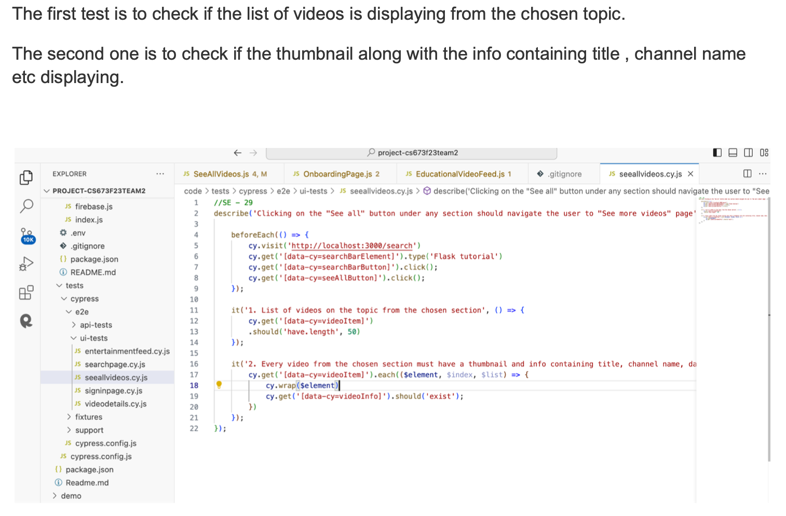
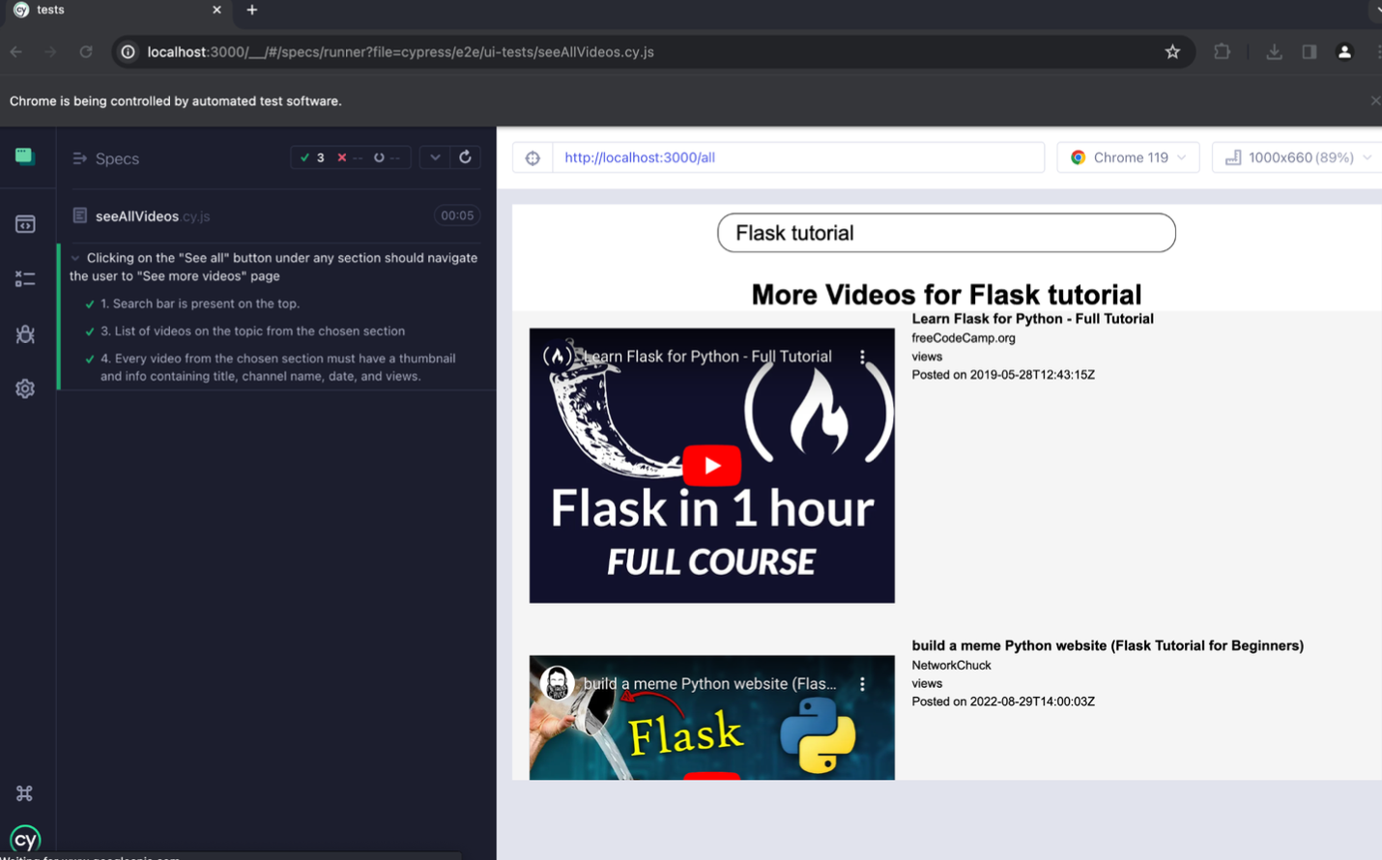
Testing
Manual
UI Tests :

Slide 16
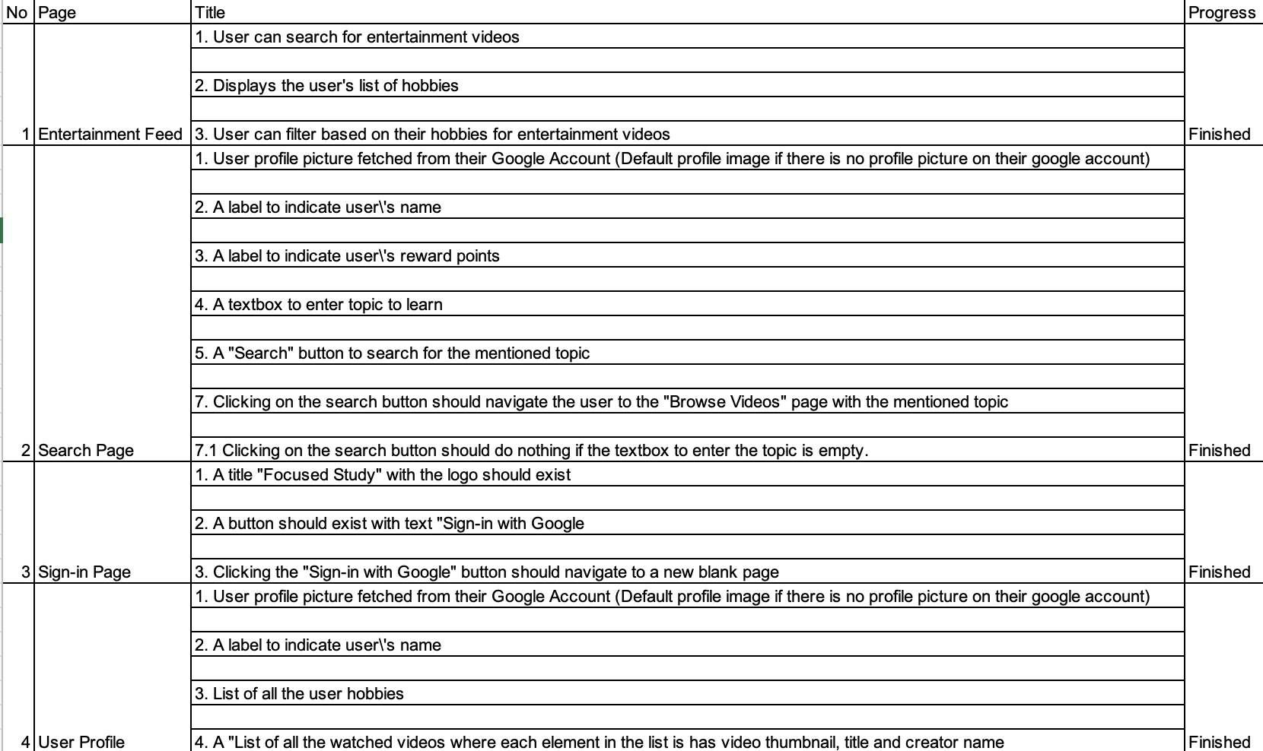
Testing

Slide 17
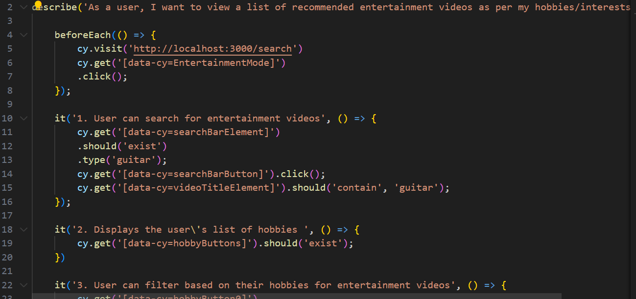

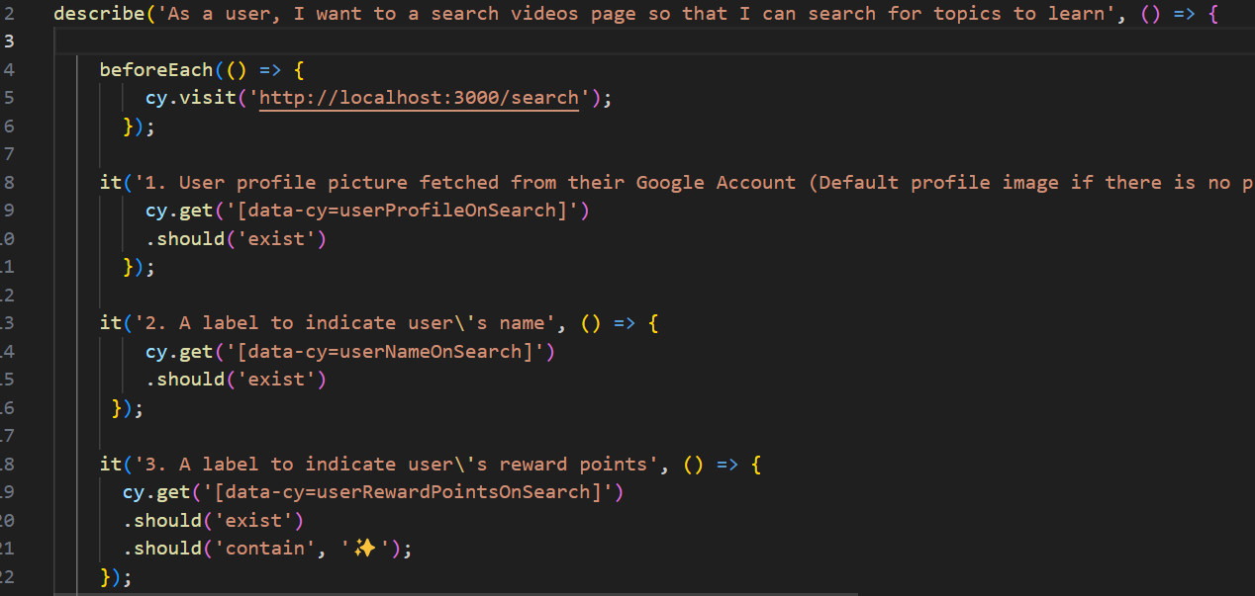
Test Case Examples
Educational Video Feed Test cases
Search Page Test cases

Slide 18
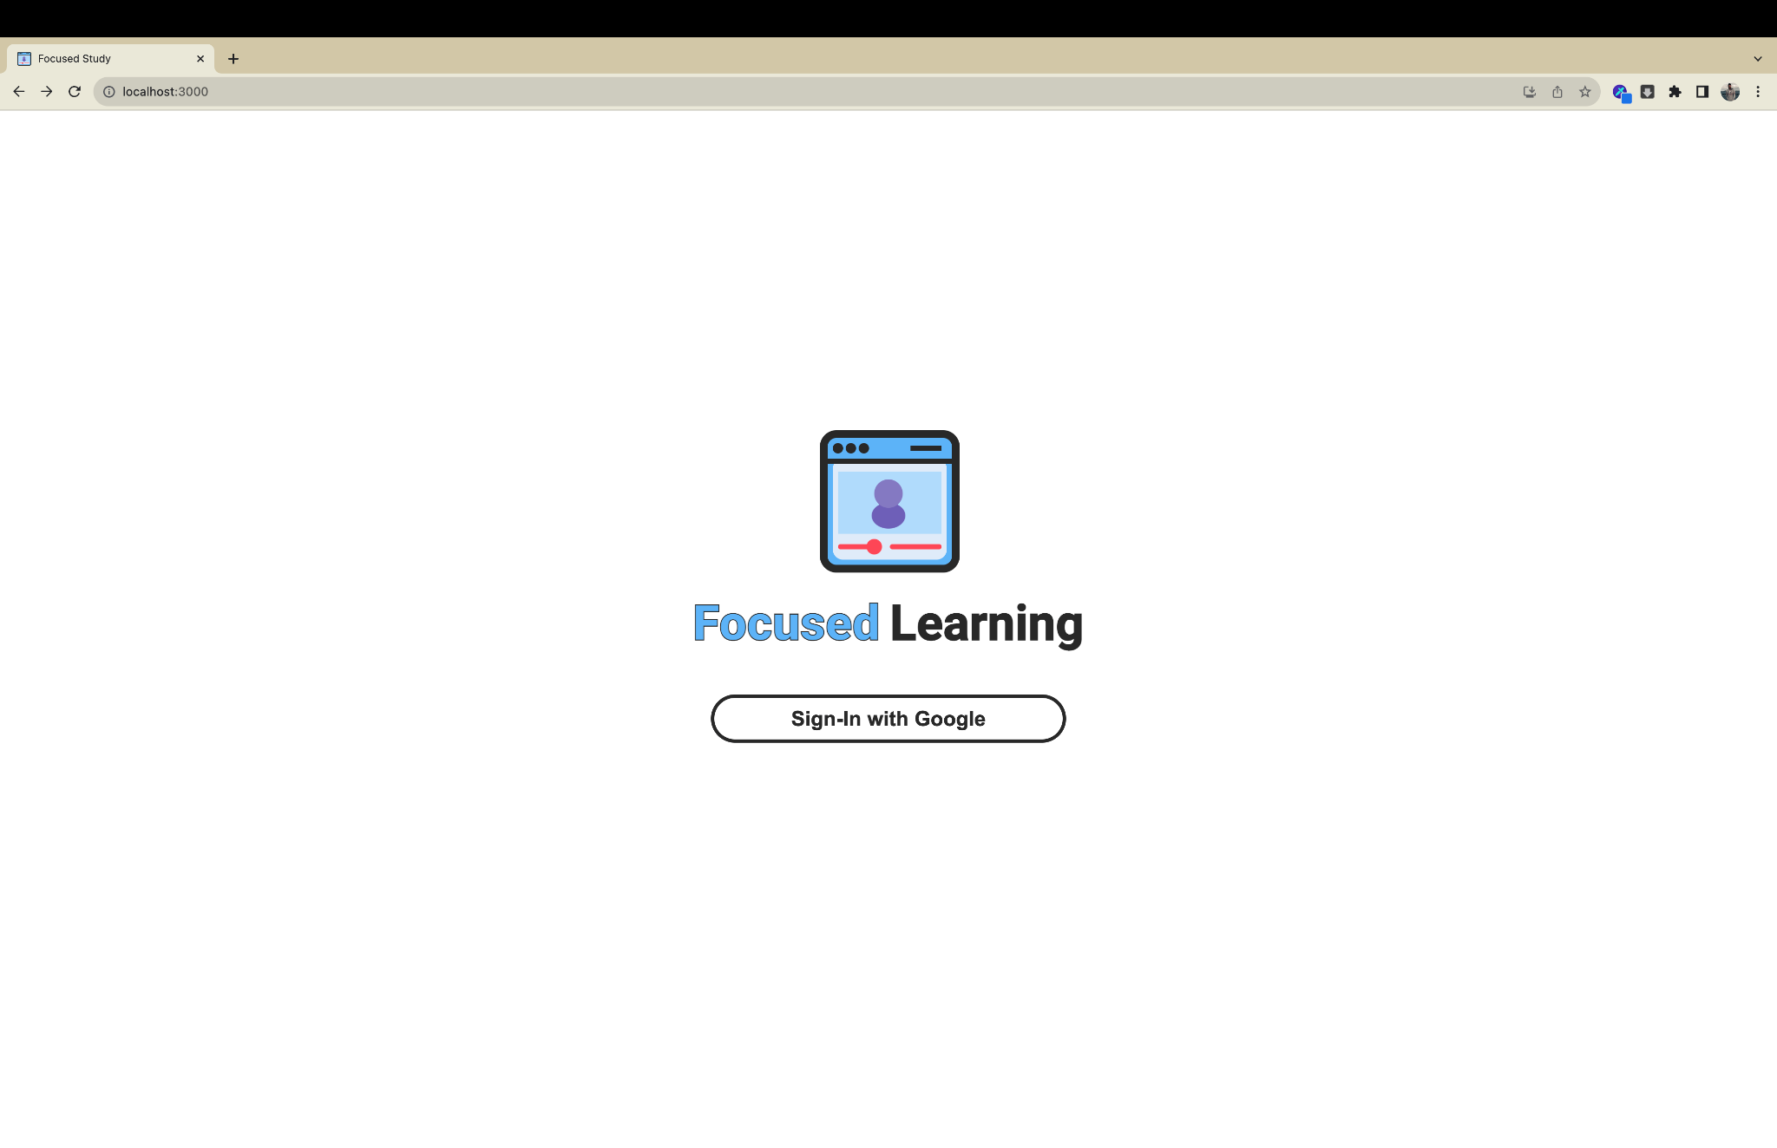
Security
We are using Google Authentication and Firebase Authentication to allow users to access their accounts

Slide 19

1)Data Encryption
2)OAuth 2.0 Protocol
3)Secure Token Management
4)API Security
5)Continuous Security Monitoring

Slide 20





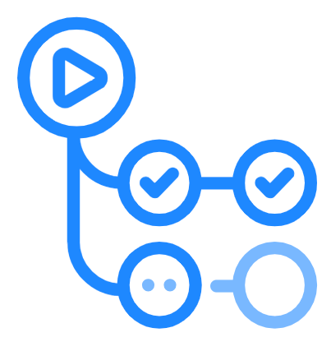
Tools
JIRA
VSCode
We used JIRA for planning sprints and distributing tasks among team members
We used VSCode as the IDE for development since it provides extensions and plugins for both Python and React frameworks.
Git
Git is our version control tool for maintaining the project, we used git for issue tracking as well.
GitHub Actions
CodeQL
SAST tool to help discover vulnerabilities across codebase, for both frontend and backend.
Dependency Review
Continuously checking the code for vulnerabilities in the libraries/functions imported
GitHub Action Tester
Would be used for automating the testing process

Slide 21
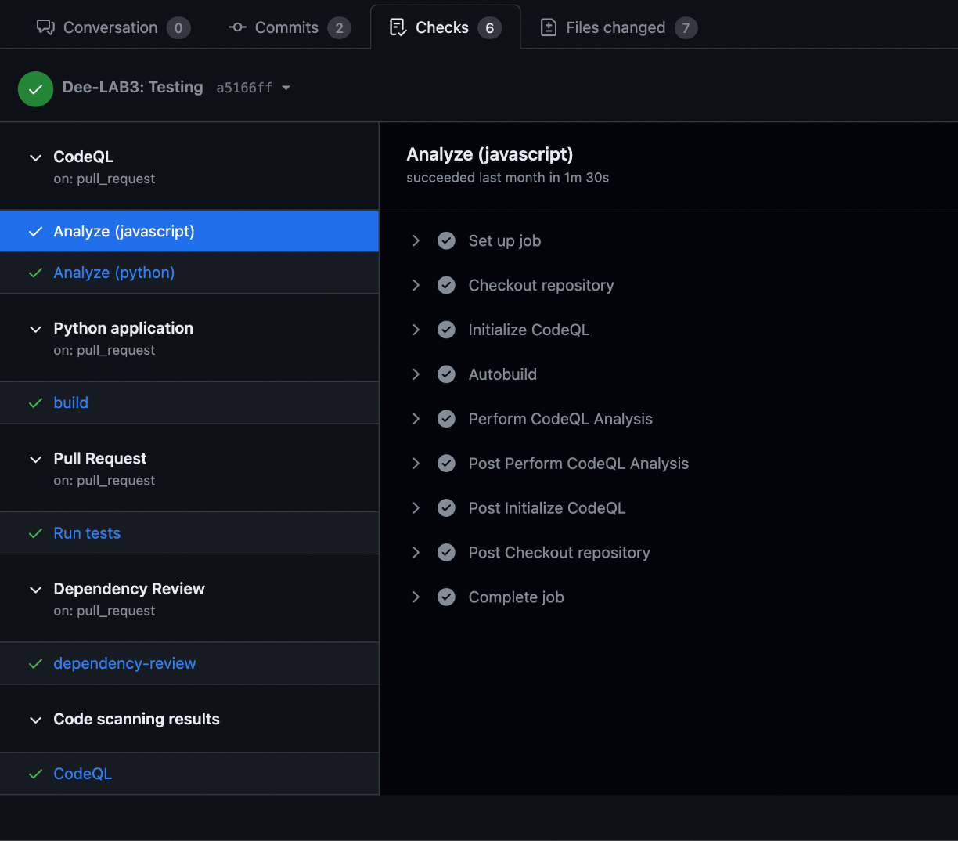
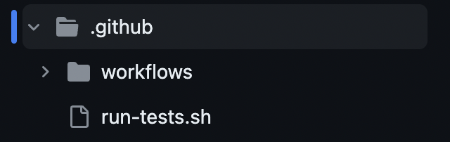
Github Actions in Action

Slide 22
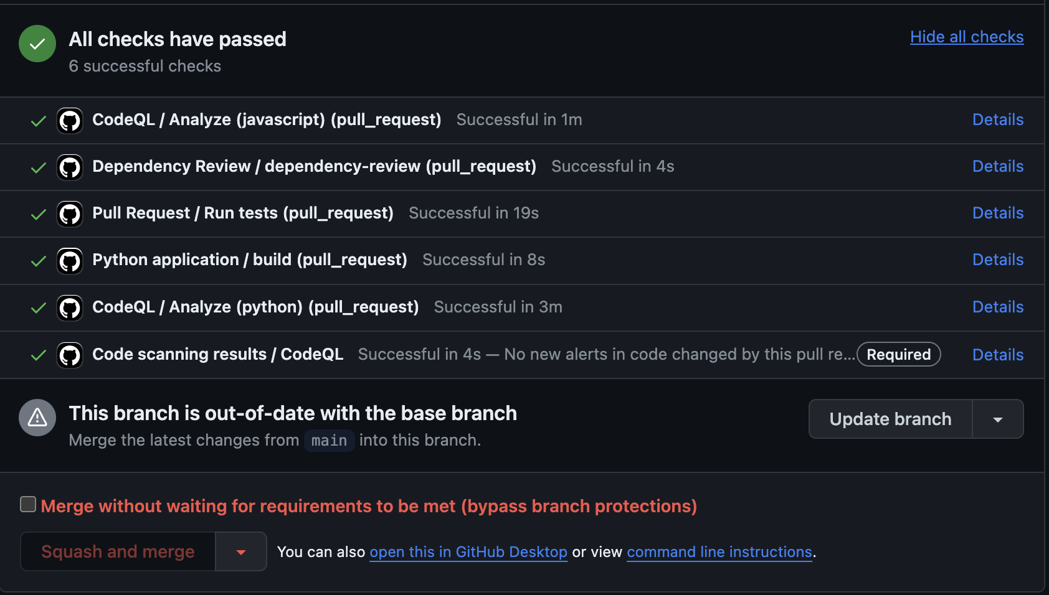
Github Actions in Action

Slide 23
DEMO

Slide 24
Thank You

